Slide 1


GAYATRI VIDYA PARISHAD
COLLEGE FOR DEGREE AND PG COURSES (A)
DEPARTMENT OF COMPUTER SCIENCE
DESIGN OF PORTABLE LAND PARAMETER MEASURING DEVICE ON MACHINE LEARNING USING IoT
By
D.PRASANTH KUMAR
PG232406003
(2023-25)
SEM-IV
Project Guide:
Mr.B.DIVAKAR
Assistant professor
Department of Computer Applications

Slide 2
CONTENTS
ABSTRACT
FUNCTIONAL REQUIREMENTS
NON-FUNCTIONAL REQUIREMENTS
UML DIAGRAMS
  USE CASE DIAGRAM
  SEQUENCE DIAGRAM (Farmer/User)
  SEQUENCE DIAGRAM(Researcher)
  ACTIVITY DIAGRAM
CONCLUSION

Slide 3
ABSTRACT
The Portable Land Parameter Measuring Device integrates machine learning (ML) to enable real-time monitoring of critical soil and environmental parameters (moisture, pH, temperature, EC, ambient temperature, humidity) in remote field conditions. Designed for farmers, researchers, and land managers, it combines capacitive, thermistor, and conductivity sensors controlled by a microcontroller. The lightweight, weatherproof device features a solar-rechargeable battery, OLED/LCD display, and Bluetooth/Wi-Fi connectivity for data transfer. By providing actionable insights through embedded ML algorithms, it supports precision agriculture, optimizes resource use, and enhances sustainable land management. This cost-effective, user-friendly solution bridges the gap between manual field analysis and smart, data-driven decision-making

Slide 4
FUNCTIONAL REQUIREMENTS
Inputs and Outputs
Input:
The system receives real-time sensor data from:
Soil Moisture Sensor (measures water content in soil)
Soil pH Sensor (indicates soil acidity/alkalinity)
Soil Temperature Sensor
Electrical Conductivity (EC) Sensor (detects salinity/nutrient level)
Ambient Humidity & Temperature Sensor
User input to start the device or initiate data calibration.
Wireless commands for remote monitoring via Bluetooth/Wi-Fi.

Slide 5
Process:
The ESP32 microcontroller initializes and calibrates all sensors.
The device collects and processes soil and environmental data.
Data is digitized, analyzed, and converted into readable units.
Optional ML models predict crop yield or identify risks.
The system manages power usage through sleep/wake cycles for efficiency.
Output:
Real-time sensor readings displayed on the LCD screen (Display).
Data is transmitted via Bluetooth/Wi-Fi to mobile or cloud interfaces.
Visual or app-based alerts if soil values exceed predefined thresholds.

Slide 6
Stored sensor data can be retrieved or exported for long-term analysis.
Insightful recommendations for irrigation and soil management based on ML output.

Slide 7
NON-FUNCTIONAL REQUIREMENTS
Software Requirements:
Arduino IDE
Python for Machine Learning
Hardware Requirements:
Processor : ESP32
RAM : ~320KB SRAM
Storage: Flash Storage – 4 MB

Slide 8
NON-FUNCTIONAL REQUIREMENTS
Performance Requirements
The device must collect and process sensor data within 2–3 seconds of activation.
It should support real-time display of soil parameters with minimal delay.
Wireless communication (Bluetooth/Wi-Fi) must transmit data reliably within a 10–15 meter range.
Reliability Requirements
The system should maintain stable performance under varying environmental conditions.
Sensors and microcontroller must operate continuously for at least 8 hours on full charge.
The device should recover gracefully from minor system faults or sensor disconnects.
Usability Requirements
The interface (display and/or app) must be simple, intuitive, and readable for non-technical users (e.g., farmers).
Setup time (including calibration) should not exceed 2 minutes.

Slide 9
Portability Requirements
The system should be lightweight, compact, and weather-resistant, allowing easy field transport.
It must function effectively in outdoor conditions (sunlight, dust, mild rain).
Maintainability Requirements
The device must allow easy replacement of sensors or battery if needed.
Modular design preferred to facilitate repairs and upgrades.
Scalability Requirements
The system should allow integration with additional sensors or cloud platforms in the future.
Must support multiple device deployment in larger field areas if needed.

Slide 10
UML DIAGRAMS
Use Case Diagram
Sequence Diagram (User)
Sequence Diagram (Researcher)
Activity Diagram

Slide 11
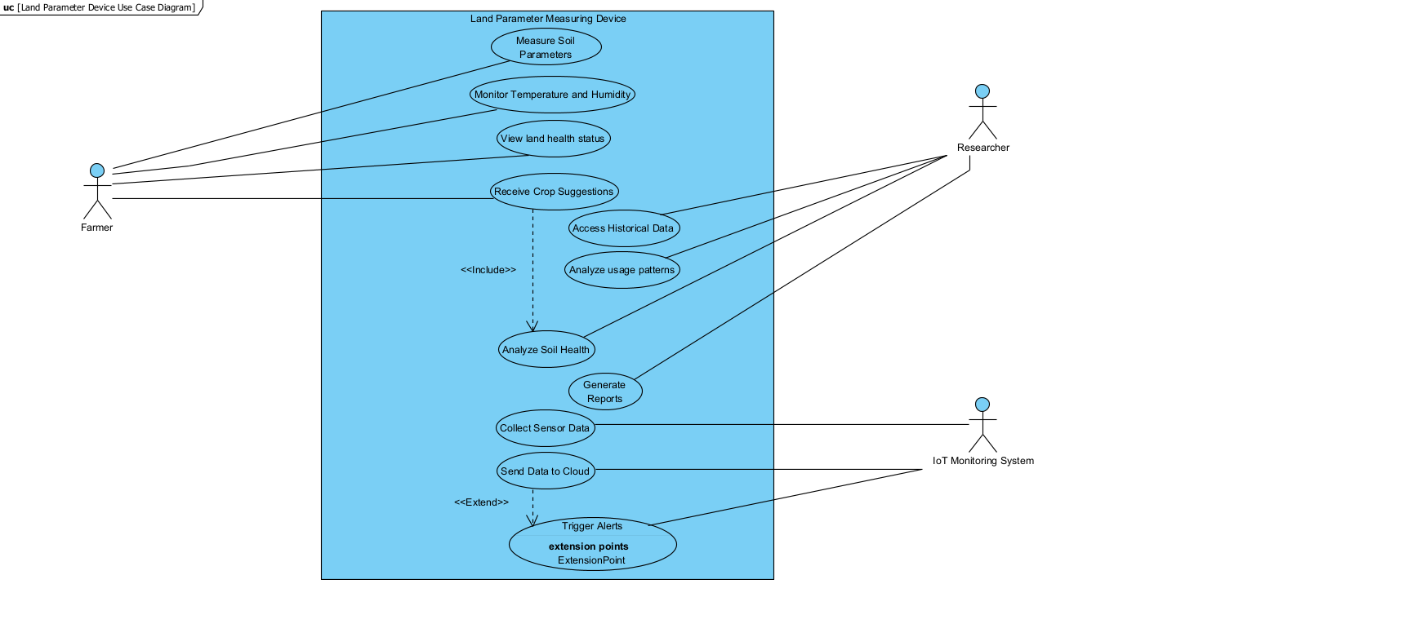
Use Case Diagram

Slide 12
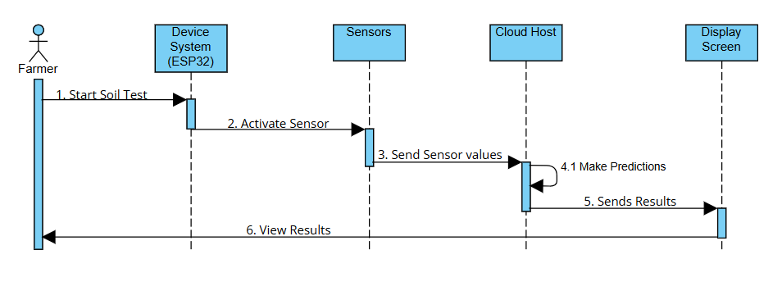
Sequence Diagram (Farmer)

Slide 13
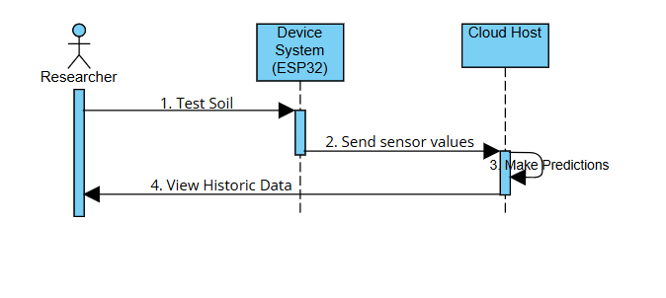
Sequence Diagram (Researcher)

Slide 14
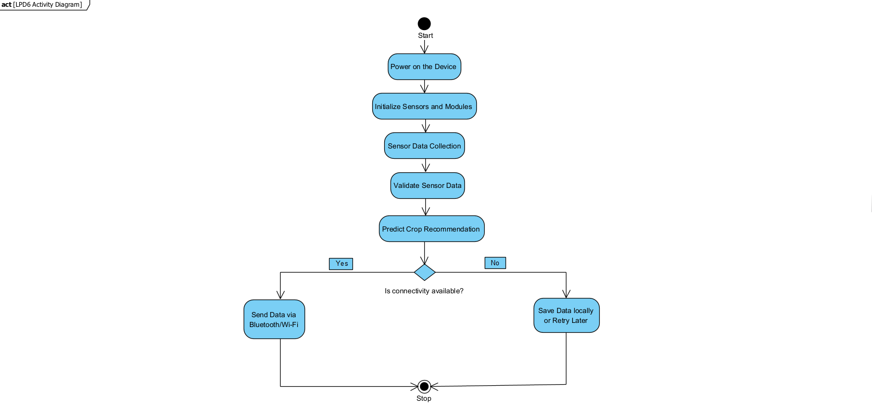
Activity Diagram

Slide 15
CONCLUSION
The development of a portable land parameter measuring device powered by machine learning holds significant potential for revolutionizing agricultural practices and environmental monitoring. By providing real-time data and analytical insights, this device can empower farmers, scientists, and researchers to make informed decisions, optimize resource utilization, and contribute to sustainable land management and environmental conservation.

